Slide 1

Classes and Objects,
State and Behavior
"A 'class' is where we teach an 'object' to behave."
-Rich Pattis
Copyright Pearson Education, 2010_x000b_Based on slides bu Marty Stepp and Stuart Reges _x000b_from http://www.buildingjavaprograms.com/

Slide 2
Classes and objects
class: A program entity that represents either:
  1. A program / module, or
  2. A template for a new type of objects.
  Example classes: String, Random, JFileChooser, Scanner, File, …
object: An entity that combines state and behavior.
  object-oriented programming (OOP): Programs that perform their behavior as interactions between objects.
EE 422C

Slide 3
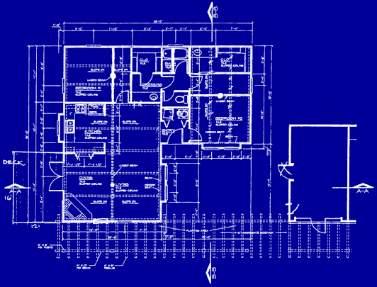

Blueprint analogy
iPod blueprint
state:
current song
volume
battery life
behavior:
power on/off
change station/song
change volume
choose random song
creates
iPod #1
state:
song = "1,000,000 Miles"
volume = 17
battery life = 2.5 hrs
behavior:
power on/off
change station/song
change volume
choose random song
iPod #2
state:
song = "Letting You"
volume = 9
battery life = 3.41 hrs
behavior:
power on/off
change station/song
change volume
choose random song
iPod #3
state:
song = "Discipline"
volume = 24
battery life = 1.8 hrs
behavior:
power on/off
change station/song
change volume
choose random song
EE 422C

Slide 4
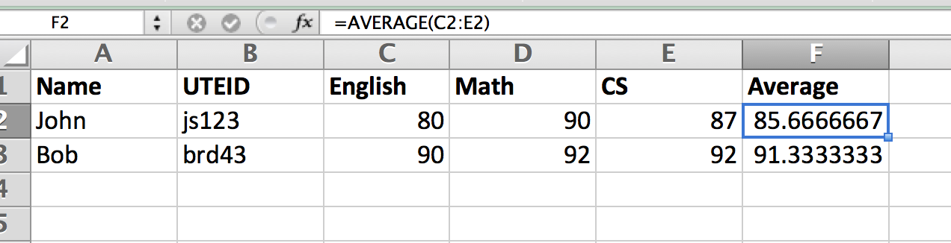
Spreadsheet analogy
Methods are
formulas.
Field names
in top row.
Student objects
in rows.
EE 422C

Slide 5
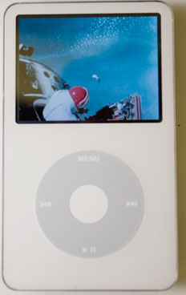
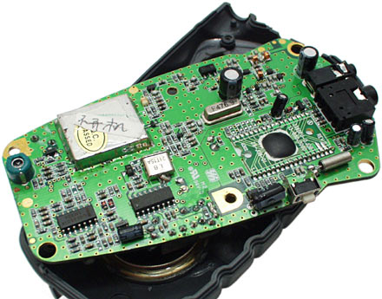
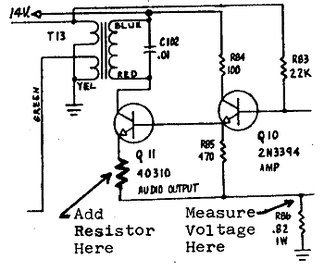
Abstraction
abstraction: A distancing between ideas and details.
  We can use objects without knowing how they work.
abstraction in an iPod:
  You understand its external behavior (buttons, screen).
  You don't understand its inner details, and you don't need to.
EE 422C

Slide 6
Our task
In the following slides, we will implement a Point class as a way of learning about defining classes.
  We will define a type of objects named Point.
  Each Point object will contain x/y data called fields.
  Each Point object will contain behavior called methods.
  Client programs will use the Point objects.
EE 422C

Slide 7
Point objects (desired)
  Point p1 = new Point(5, -2);
  Point p2 = new Point(); // origin, (0, 0)
Data in each Point object:
Methods in each Point object:
Field name | Description
x | the point's x-coordinate
y | the point's y-coordinate
Method name | Description
setLocation(x, y) | sets the point's x and y to the given values
translate(dx, dy) | adjusts the point's x and y by the given amounts
distance(p) | how far away the point is from point p
draw(g) | displays the point on a drawing panel
EE 422C

Slide 8
Point class as blueprint
  The class (blueprint) will describe how to create objects.
  Each object will contain its own data and methods.
Point class
state:
int x, y
behavior:
setLocation(int x, int y)
translate(int dx, int dy)
distance(Point p)
draw(Graphics g)
Point object #1
state:
x = 5, y = -2
behavior:
setLocation(int x, int y)
translate(int dx, int dy)
distance(Point p)
draw(Graphics g)
Point object #2
state:
x = -245, y = 1897
behavior:
setLocation(int x, int y)
translate(int dx, int dy)
distance(Point p)
draw(Graphics g)
Point object #3
state:
x = 18, y = 42
behavior:
setLocation(int x, int y)
translate(int dx, int dy)
distance(Point p)
draw(Graphics g)
EE 422C

Slide 9
Object state:
Fields

Slide 10
Point class, version 1
  public class Point {
  int x;
  int y;
  }
  Save this code into a file named Point.java.
The above code creates a new type named Point.
  Each Point object contains two pieces of data:
    an int named x, and
    an int named y.
  Point objects do not contain any behavior (yet).
EE 422C

Slide 11
Fields
field: A variable inside an object that is part of its state.
  Each object has its own copy of each field.
Declaration syntax:
  type name;
  Example:
  public class Student {
  String name; // each Student object has a
  double gpa; // name and gpa field
  }
EE 422C

Slide 12
Accessing fields
Other classes can access/modify an object's fields.
  depending on the access modifier
  access: variable.field
  modify: variable.field = value;
Example:
  Point p1 = new Point();
  Point p2 = new Point();
  System.out.println("the x-coord is " + p1.x); // access
  p2.y = 13; // modify
EE 422C

Slide 13
A class and its client
Point.java is not, by itself, a runnable program.
  A class can be used by client programs.
Point.java (class of objects)
public class Point {
int x;
int y;
}
PointMain.java (client program)
public class PointMain {
main(String args) {
Point p1 = new Point();
p1.x = 7;
p1.y = 2;
Point p2 = new Point();
p2.x = 4;
p2.y = 3;
...
}
}
x | 7 | y | 2
x | 4 | y | 3
EE 422C

Slide 14
PointMain client example
public class PointMain {
public static void main(String[] args) {
// create two Point objects
Point p1 = new Point();
p1.y = 2;
Point p2 = new Point();
p2.x = 4;
System.out.println(p1.x + ", " + p1.y); // 0, 2
// move p2 and then print it
p2.x += 2;
p2.y++;
System.out.println(p2.x + ", " + p2.y); // 6, 1
}
}
EE 422C

Slide 15
Object behavior:
Methods

Slide 16
Client code
Suppose our client program wants to get the distance from the origin of a Point objects:
  // get distance of a point from origin, in main method.
  Point p1 = new Point();
  p1.x = 15;
  p1.y = 37;
  double d = getDistanceFromOrigin(p);
  …
  // Gets the distance. Static method in the same class.
  public static double getDistanceFromOrigin(Point p) {
  return Math.sqrt(p1.x*p1.x + p1.y*p1.y);
  }
EE 422C

Slide 17
Problems with static solution
We are missing a major benefit of objects: code reuse.
  Every program that draws Points would need a getDistanceFromOrigin method.
The syntax doesn't match how we're used to using objects.
  getDistanceFromOrigin(p1); // static (bad)
The point of classes is to combine state and behavior.
  The distance behavior is closely related to a Point's data.
  The method belongs inside each Point object.
  p1.getDistanceFromOrigin(); // inside the object (correct)
EE 422C

Slide 18
Instance methods
instance method (or object method): Exists inside each object of a class and gives behavior to each object.
  public type name(parameters) {
  statements;
  }
  same syntax as static methods, but without static keyword
  Example:
  public void shout() {
  System.out.println("HELLO THERE!");
  }
EE 422C

Slide 19
Instance method example
public class Point {
int x;
int y;
public double getDistanceFromOrigin() {
...
}
}
The getDistanceFromOrigin method no longer has a Point p parameter.
How will the method know which point to use?
  How will the method access that point's x/y data?
EE 422C

Slide 20
Point objects w/ method
Each Point object has its own copy of the getDistanceFromOrigin method, which operates on that object's state:
  Point p1 = new Point();
  p1.x = 7;
  p1.y = 2;
  Point p2 = new Point();
  p2.x = 4;
  p2.y = 3;
  p1.getDistanceFromOrigin();
  p2.getDistanceFromOrigin();
p1
public double getDistanceFromOrigin(){
// this code can see p1's x and y
}
x | 7 | y | 2
public double getDistanceFromOrigin(){
// this code can see p2's x and y
}
x | 4 | y | 3
p2
EE 422C

Slide 21
The implicit parameter
implicit parameter:
The object on which an instance method is called.
  During the call p1.getDistanceFromOrigin();
  the object referred to by p1 is the implicit parameter.
  During the call p2.getDistanceFromOrigin();
  the object referred to by p2 is the implicit parameter.
  The instance method can refer to that object's fields.
    We say that it executes in the context of a particular object.
    getDistanceFromOrigin can refer to the x and y of the object it was called on.
EE 422C

Slide 22
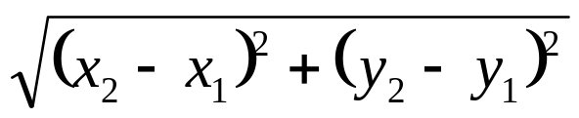
Class method questions
Write a method translate that changes a Point's location by a given dx, dy amount.
Write a method distanceFromOrigin that returns the distance between a Point and the origin, (0, 0).
Use the formula:
  Modify the Point and client code to use these methods.
EE 422C

Slide 23
Class method answers
public class Point {
int x;
int y;
public void translate(int dx, int dy) {
x = x + dx;
y = y + dy;
}
public double distanceFromOrigin() {
return Math.sqrt(x * x + y * y);
}
}
EE 422C

Slide 24
Kinds of methods
accessor: A method that lets clients examine object state.
  Examples: distance, distanceFromOrigin
  often has a non-void return type
mutator: A method that modifies an object's state.
  Examples: setLocation, translate
EE 422C

Slide 25
Mutator method answers
public void setLocation(int newX, int newY) {
x = newX;
y = newY;
}
public void translate(int dx, int dy) {
x = x + dx;
y = y + dy;
}
// alternative solution that utilizes setLocation
public void translate(int dx, int dy) {
setLocation(x + dx, y + dy);
}
EE 422C

Slide 26
The toString method
tells Java how to convert an object into a String
  Point p1 = new Point(7, 2);
  System.out.println("p1: " + p1);
  // the above code is really calling the following:
  System.out.println("p1: " + p1.toString());
Every class has a toString, even if it isn't in your code.
  Default: class's name @ object's hashcode which is likely its memory address (base 16)
  Point@9e8c34
EE 422C

Slide 27
Object initialization: constructors

Slide 28
Constructors
constructor: Initializes the state of new objects.
  public type(parameters) {
  statements;
  }
  runs when the client uses the new keyword
  no return type is specified;
  it implicitly "returns" the new object being created
  If a class has no constructor, Java gives it a default constructor with no parameters that sets all fields to 0.
EE 422C

Slide 29
Client code, version 3
public class PointMain3 {
public static void main(String[] args) {
// create two Point objects
Point p1 = new Point(5, 2);
Point p2 = new Point(4, 3);
// print each point
System.out.println(p1.toString());
System.out.println(p2.toString());
// move p2 and then print it again
p2.translate(2, 4);
System.out.println(p2.toString());
}
}
OUTPUT:
p1: (5, 2)
p2: (4, 3)
p2: (6, 7)
EE 422C

Slide 30
Multiple constructors
A class can have multiple constructors.
  Each one must accept a unique set of parameters.
Exercise: Write a Point constructor with no parameters that initializes the point to (0, 0).
  // Constructs a new point at (0, 0).
  public Point() {
  x = 0;
  y = 0;
  }
EE 422C

Slide 31
Common constructor bugs
1. Re-declaring fields as local variables ("shadowing"):
  public Point(int initialX, int initialY) {
  int x = initialX;
  int y = initialY;
  }
  This declares local variables with the same name as the fields, rather than storing values into the fields. The fields remain 0.
EE 422C

Slide 32
Common constructor bugs
Accidentally giving the constructor a return type:
public void Point(int initialX, int initialY) {
  x = initialX;
  y = initialY;
  }
  This is actually not a constructor, but a method named Point
EE 422C

Slide 33
Encapsulation
encapsulation: Hiding implementation details from clients.
  Encapsulation forces abstraction.
    separates external view (behavior) from internal view (state)
    protects the integrity of an object's data
EE 422C

Slide 34
Private fields
A field that cannot be accessed from outside the class
  private type name;
  Examples:
  private int id;
  private String name;
Client code won't compile if it accesses private fields:
  PointMain.java:11: x has private access in Point
  System.out.println(p1.x);
  ^
EE 422C

Slide 35
Accessing private state
  // A "read-only" access to the x field ("accessor")
  public int getX() {
  return x;
  }
  // Allows clients to change the x field ("mutator")
  public void setX(int newX) {
  x = newX;
  }
  Client code will look more like this:
  System.out.println(p1.getX());
  p1.setX(14);
EE 422C

Slide 36
Point class, version 4
  // A Point object represents an (x, y) location.
  public class Point {
  private int x;
  private int y;
  public Point(int initialX, int initialY) {
  x = initialX;
  y = initialY;
  }
  public int getX() {
  return x;
  }
  public int getY() {
  return y;
  }
  public double distanceFromOrigin() {
  return Math.sqrt(x * x + y * y);
  }
  public void setLocation(int newX, int newY) {
  x = newX;
  y = newY;
  }
  public void translate(int dx, int dy) {
  setLocation(x + dx, y + dy);
  }
  }
EE 422C

Slide 37
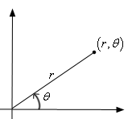
Benefits of encapsulation
Abstraction between object and clients
Protects object from unwanted access
Can change the class implementation later
  Example: Point could be rewritten in polar
  coordinates (r, θ) with the same methods.
Can constrain objects' state (invariants)
  Example: Only allow Pointss in a certain quadrant.
  Example: Only allow Dates with a month from 1-12.
EE 422C
Notes:
Write short examples here to illustrate how unwanted access can be prevented, and constraining invariants.

Slide 38
The keyword this

Slide 39
The this keyword
this : Refers to the implicit parameter inside your class.
  (a variable that stores the object on which a method is called)
  Refer to a field: this.field
  Call a method: this.method(parameters);
  One constructor this(parameters);
  can call another:
EE 422C

Slide 40
Variable shadowing
shadowing: 2 variables with same name in same scope.
  Normally illegal, except when one variable is a field.
  public class Point {
  private int x;
  private int y;
  ...
  // this is legal
  public void setLocation(int x, int y) {
  ...
  }
  In most of the class, x and y refer to the fields.
  In setLocation, x and y refer to the method's parameters.
EE 422C

Slide 41
Fixing shadowing
  public class Point {
  private int x;
  private int y;
  ...
  public void setLocation(int x, int y) {
  this.x = x;
  this.y = y;
  }
  }
Inside setLocation,
  To refer to the data field x, say this.x
  To refer to the parameter x, say x
EE 422C

Slide 42
Calling another constructor
  public class Point {
  private int x;
  private int y;
  public Point() {
  this(0, 0);// calls (x, y) constructor
  }
  public Point(int x, int y) {
  this.x = x;
  this.y = y;
  }
  ...
  }
    Avoids redundancy between constructors
    Only a constructor (not a method) can call another constructor
EE 422C

